Slide 1

CAPSTONE PROJECT
UPGRADE
Online Examination System
Under the Guidance of:
Rajashekar Sir
DEVELOPED BY:
Gadi Keerthi Sai Reddy
Kanagala Bhargavi
Mavuri Hari Mohan Sai Vinay
Poluparthi Pradeep
Sayyad Thajuddin
A Sri Saran Varma

Slide 2

CONTENTS
INTRODUCTION
AIM OF THE PROJECT
OBJECTIVE
SYSTEM REQUIREMENTS
TECHNOLOGIES USED
SCOPE
MODULE DESCRIPTION & USER CHARACTERISTICS
PROBLEM STATEMENT & SOLUTION
SCREENSHOTS OF PROJECT
ADVANTAGES
CONCLUSION

Slide 3

INTRODUCTION
Online Examination System is very useful for Students, companies or any organizations to conduct any examinations in this site.
In this age of increased competition many companies visit some of the top colleges and conduct exams manually. This manual conduction requires a lot of time, efforts and money.
The students at low grade colleges despite of having the caliber to complete are not getting enough exposure to job profiles of their choices and end up getting a low satisfying job.
So this platform will help the deserved candidates to showcase their conceptual skills through this online exams.

Slide 4
AIM OF THE PROJECT
This project aim is to provide facility to conduct online examination.
It saves time as it allows number of students to give the exam at a time and displays the results as the test gets over, so no need to wait for the result. It is automatically generated by the server.
Administrator has a privilege to create, modify and delete the test papers and also questions.
User can register, login and give the test with specific id, and can see the results as well.

Slide 5
OBJECTIVE
Online examination can reduce the hectic job of assessing the answers given by candidates manually.
Responses or the answers by the candidates can be checked automatically and instantly.
It will reduce paper work to be an integrated Online Examination System.
The result can be shown immediately to the students reducing the anxiety.
Can create various reports and graphs for evaluation purpose almost instantly when and where required .

Slide 6
SYSTEM REQUIREMENTS
SOFTWARE
JDK 1.8 and above
Mongo DB 5.0
Eclipse IDE
VS Code Editor
POSTMAN
HARDWARE
Disk Space: 1GB or above
RAM: 2GB or above

Slide 7
TECHNOLOGIES USED
Spring Boot 2.5.
Angular 8.0.0.
CSS3.
HTML5.
JPA(Java Persistence API) – MongoRepository.
Junit 4
Swagger

Slide 8
SCOPE
Online Examination System is developed or designed for educational institute like school, colleges, and private institutes to conduct logic test for their students on regular basis.
Design to provide or facilitate Administrator and User.
This can be used in educational institutions as well as in corporate world.
Can be used anywhere anytime as it is web based application(user location doesn’t matter).

Slide 9
MODULE DESCRIPTION
Home page
Login page
Register page
Exam page
Report generation page

Slide 10
USER CHARACTERISTICS
ADMIN:
Can create questions.
Modify questions.
Delete questions.
Can also see the students report.
STUDENT:
Register & Login to attend the test.
Give the Exam
Get the Result

Slide 11
HOME PAGE
In this home page where the user will first have to login by entering ‘login id’ and ‘password’ to get access.
If the user is visiting for the first time then user will have to click on the ‘Register’ button and will be directed to the new registration page where the user has to enter the all necessary required details mentioned on that page and then click on the ‘SUBMIT’ button.
Then user can proceed to exam after login. After that report page which will display
scores.

Slide 12
LOGIN PAGE
Under this login page, we have to enter the username and password credentials.
If the user has entered correct then there will a message like login successfully! and click here to exam.
When we click on click here to exam, it will move to exam page.
If the user gives incorrect details, then the message displays as please give valid
credentials and login again.

Slide 13
REGISTER PAGE
When the user appears for the first time, then candidate has to register first.
In this, there are several fields like name, email, mobile number, emailId, Date of birth, qualification, year of completion, password etc.,
The user has to enter all the fields and click on submit.
Then the message will be displayed as Registered successfully.
The data will get dispatched and stored in database.

Slide 14
EXAM PAGE
In this page, we have to select which exam do we want to write.
It consists of a set of instructions. And has a option to start test.
In each set of exam there will be some questions related to that subject.
After answering the questions we have to click on submit test.
You will get a message for test clearance and score obtained in the test.

Slide 15
REPORT GENERATION PAGE
In this page, we can able to view the score of candidate who have taken test upto now.
In the home page we will find an option as report when we can click on that we’ll find score of all and some of their details like name, email, mobile number, test which they have appeared for.

Slide 16
PROBLEM STATEMENT
Most of the currently existing portals are getting problems.
Offline examination are bit tough now a days due to pandemic.
Immediate results or score of an individual can’t be defined in offline exams.
Malpractice issues can take place in offline.

Slide 17
SOLUTION
This portal can be used by institutions to reduce stationary needed for offline examination.
Using online examination portal malpractice cannot take place.
Results are displayed immediately for analyzing.
By online examinations we can immediately take care of student with low score.
Students could easily attend and access the system of online examination.

Slide 18
PROJECT SCREENSHOTS

Slide 19
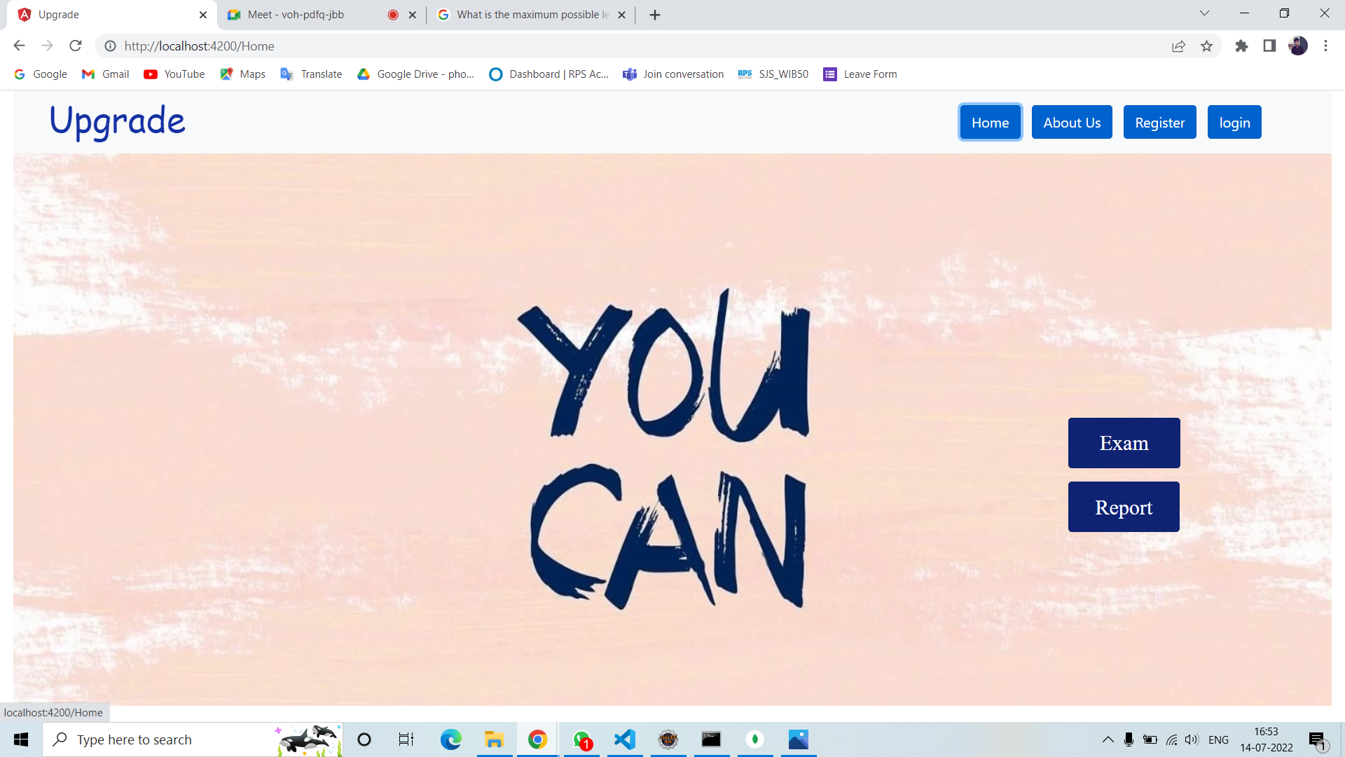
Home Page

Slide 20
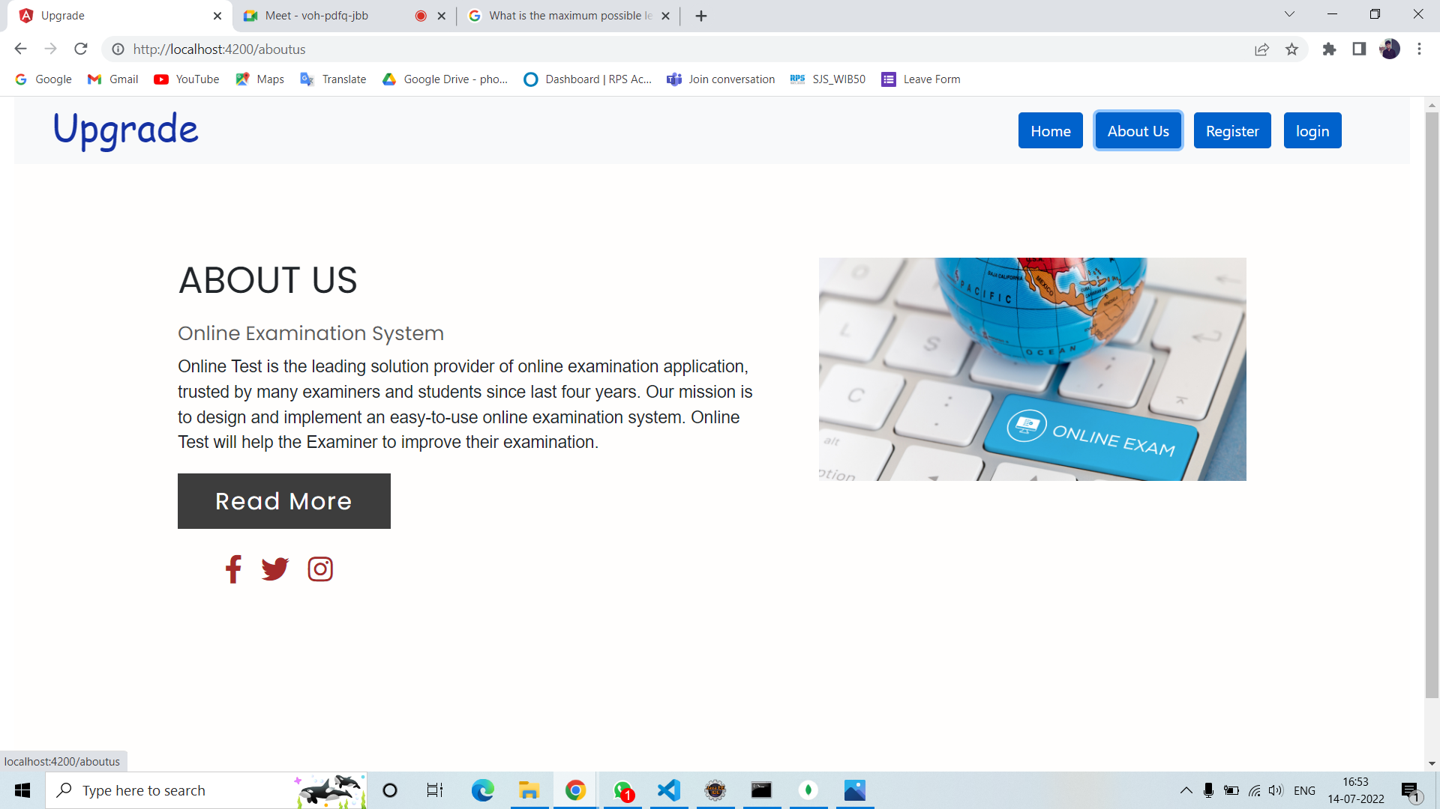
About Us

Slide 21
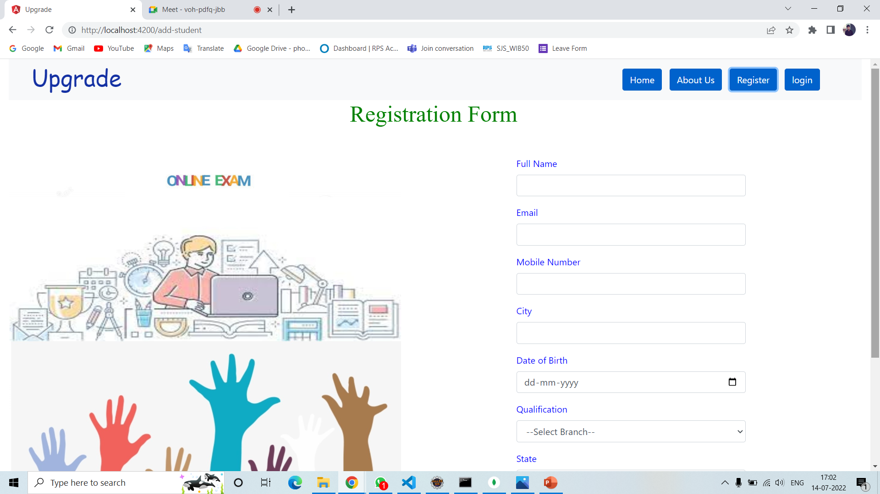
Registration Page

Slide 22
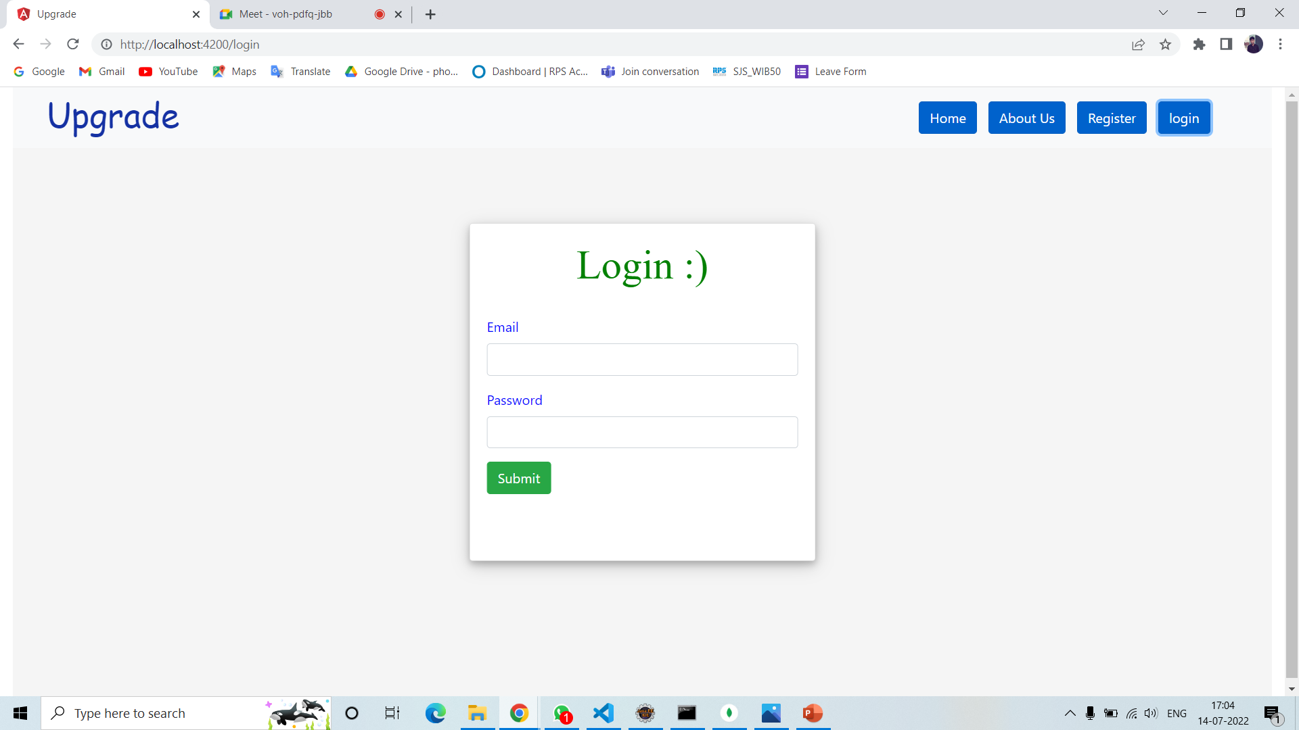
Login Page

Slide 23
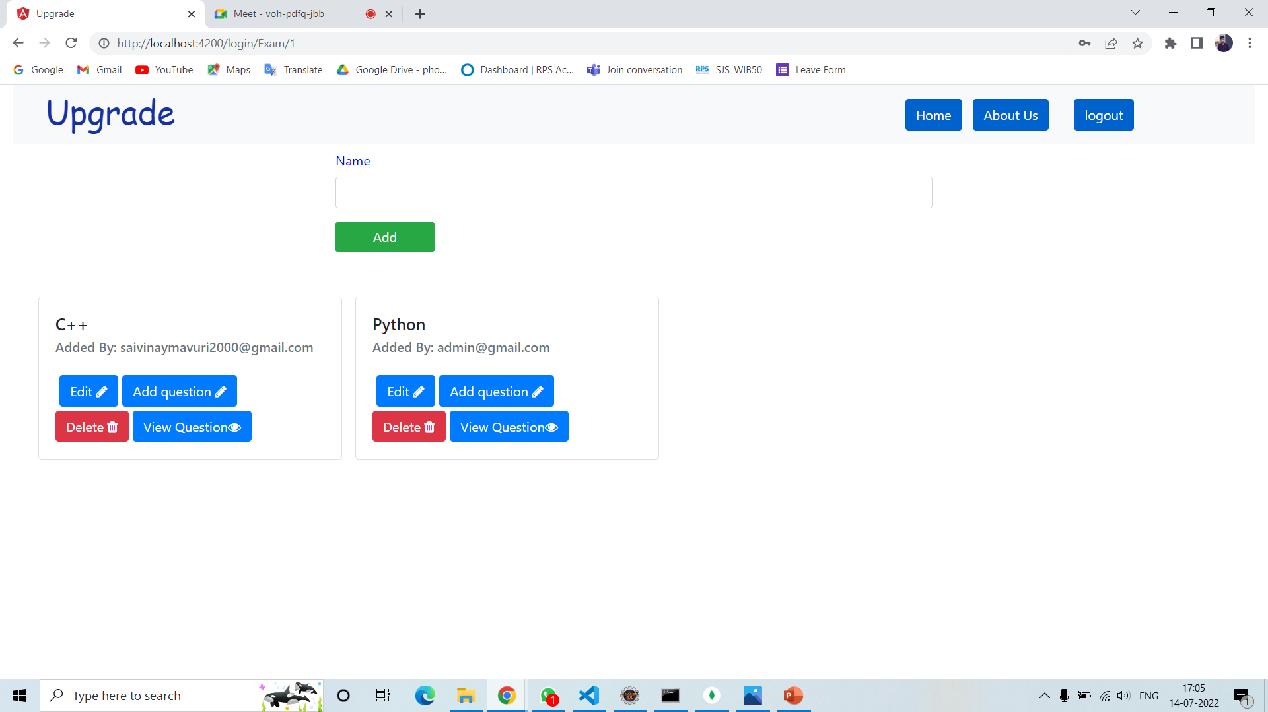
Admin Exam Page
Here admin can add,update or modify exams

Slide 24
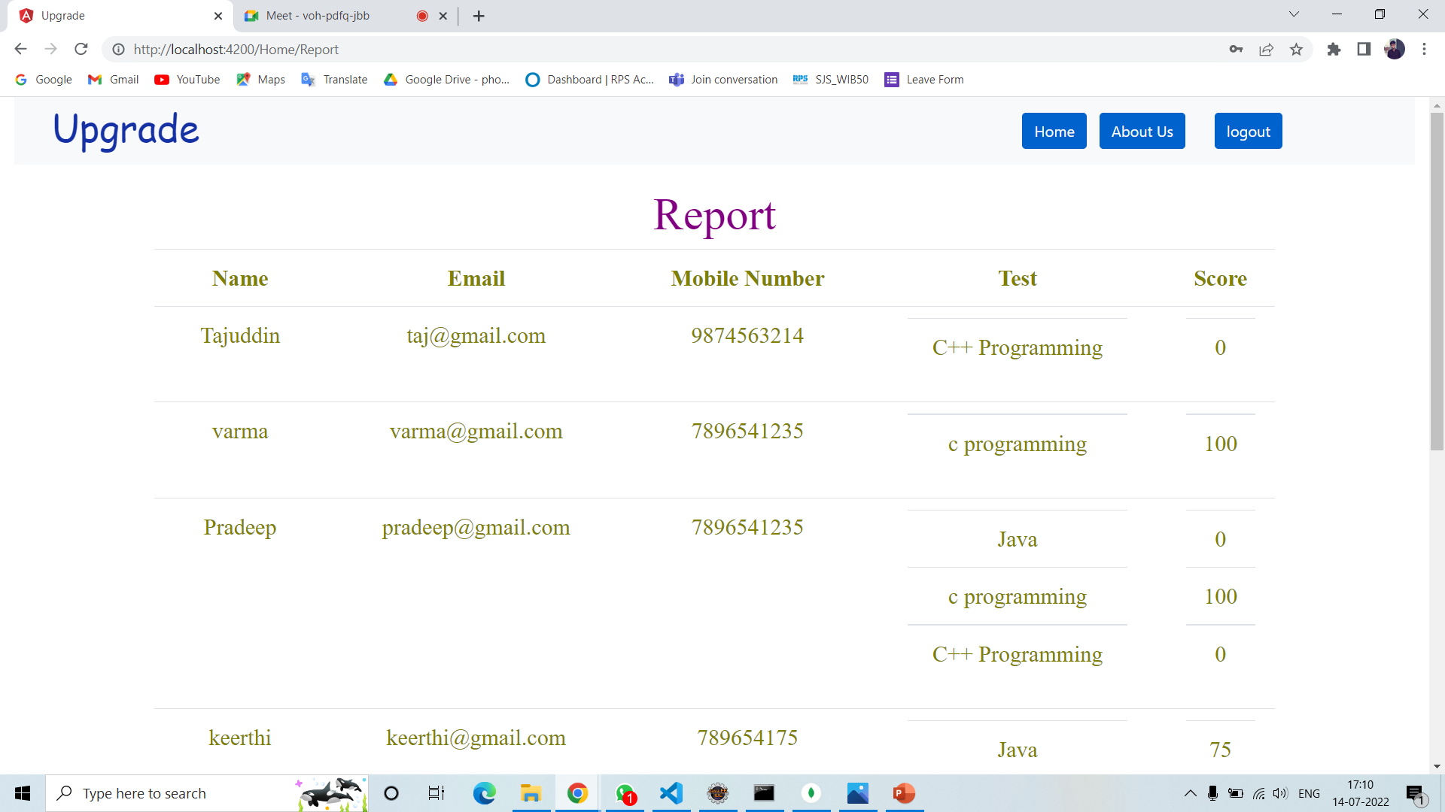
Admin Report

Slide 25
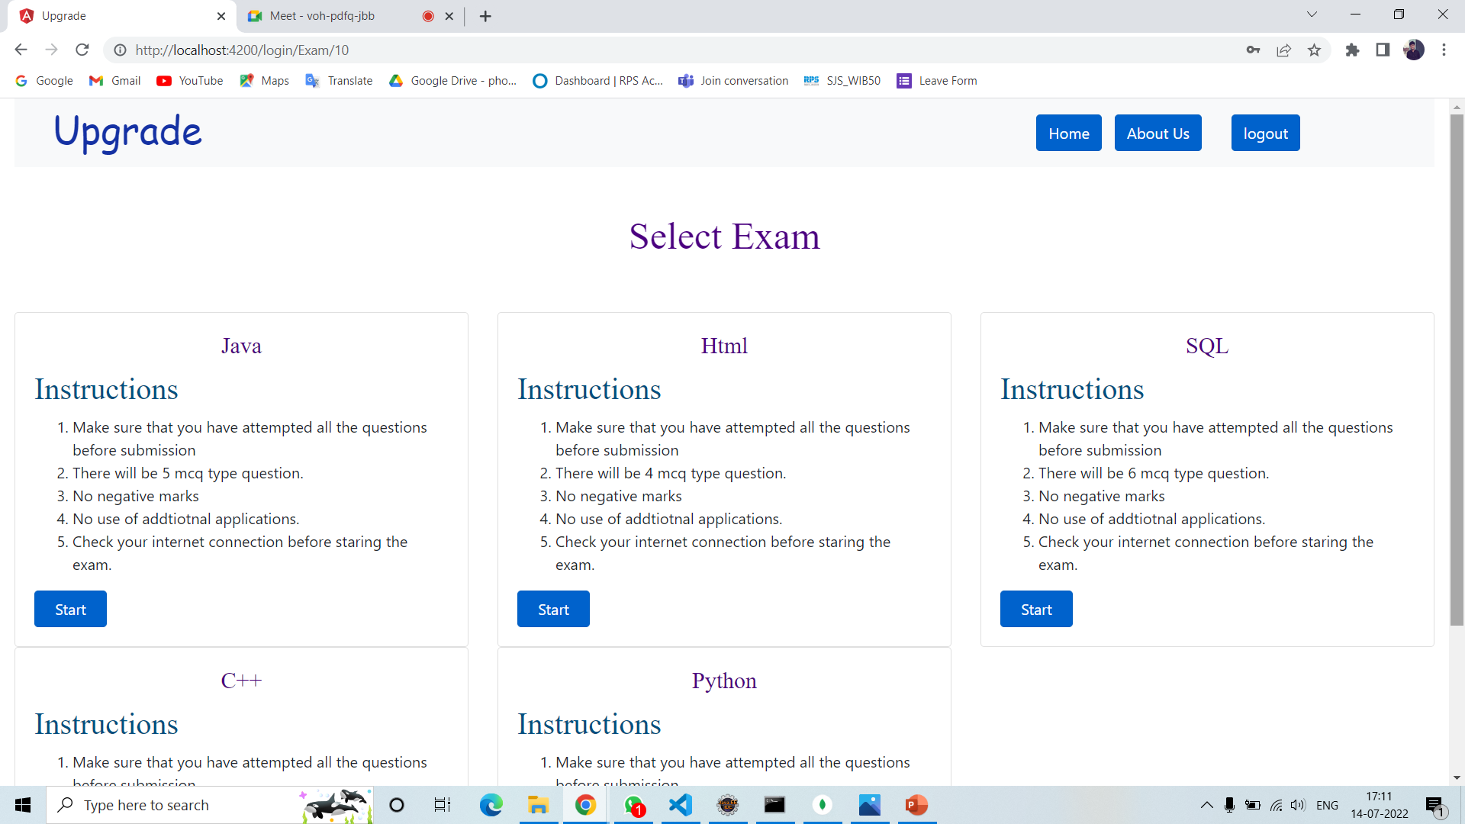
User Exam Page

Slide 26
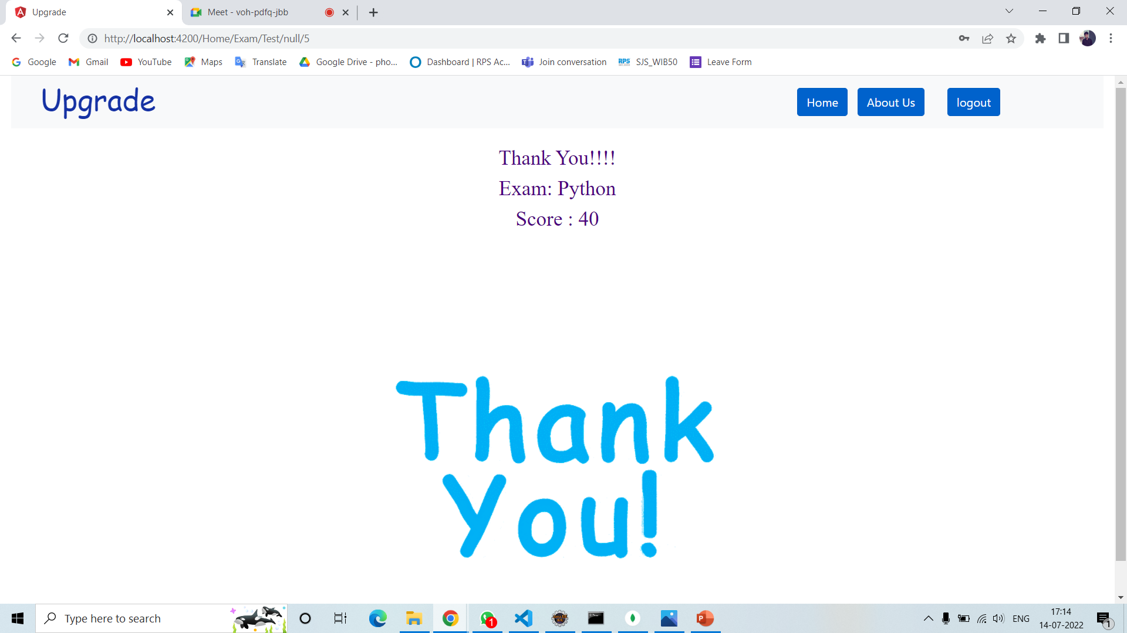
User Result

Slide 27
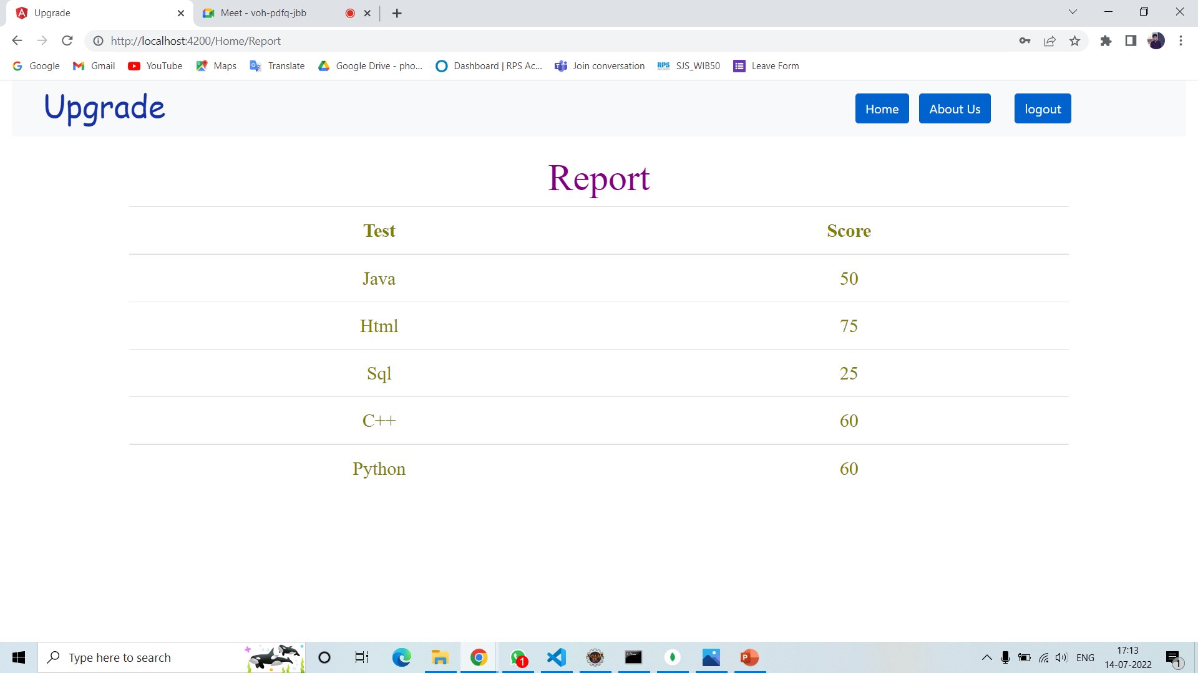
User Report

Slide 28
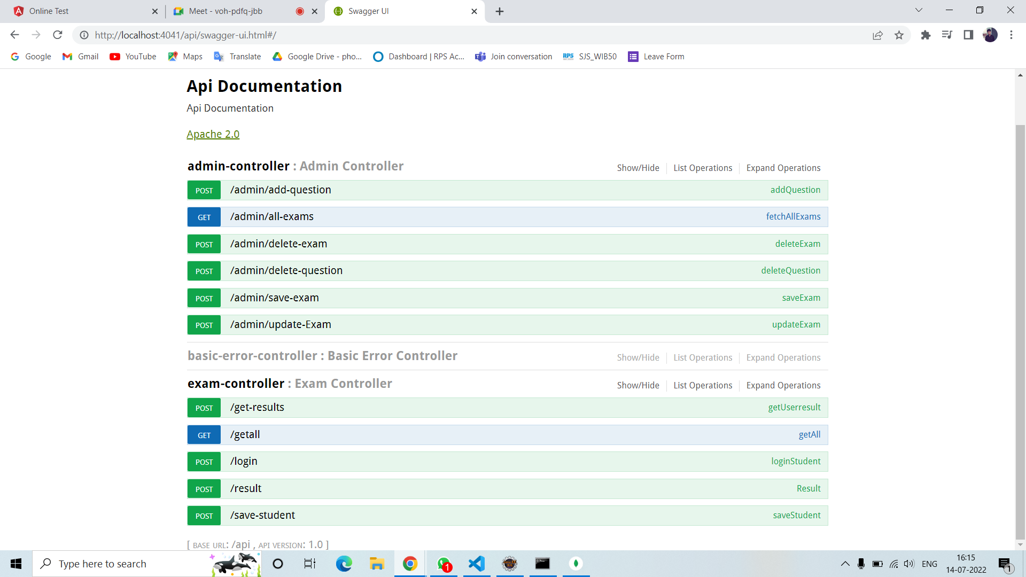
SWAGGER REPORT

Slide 29
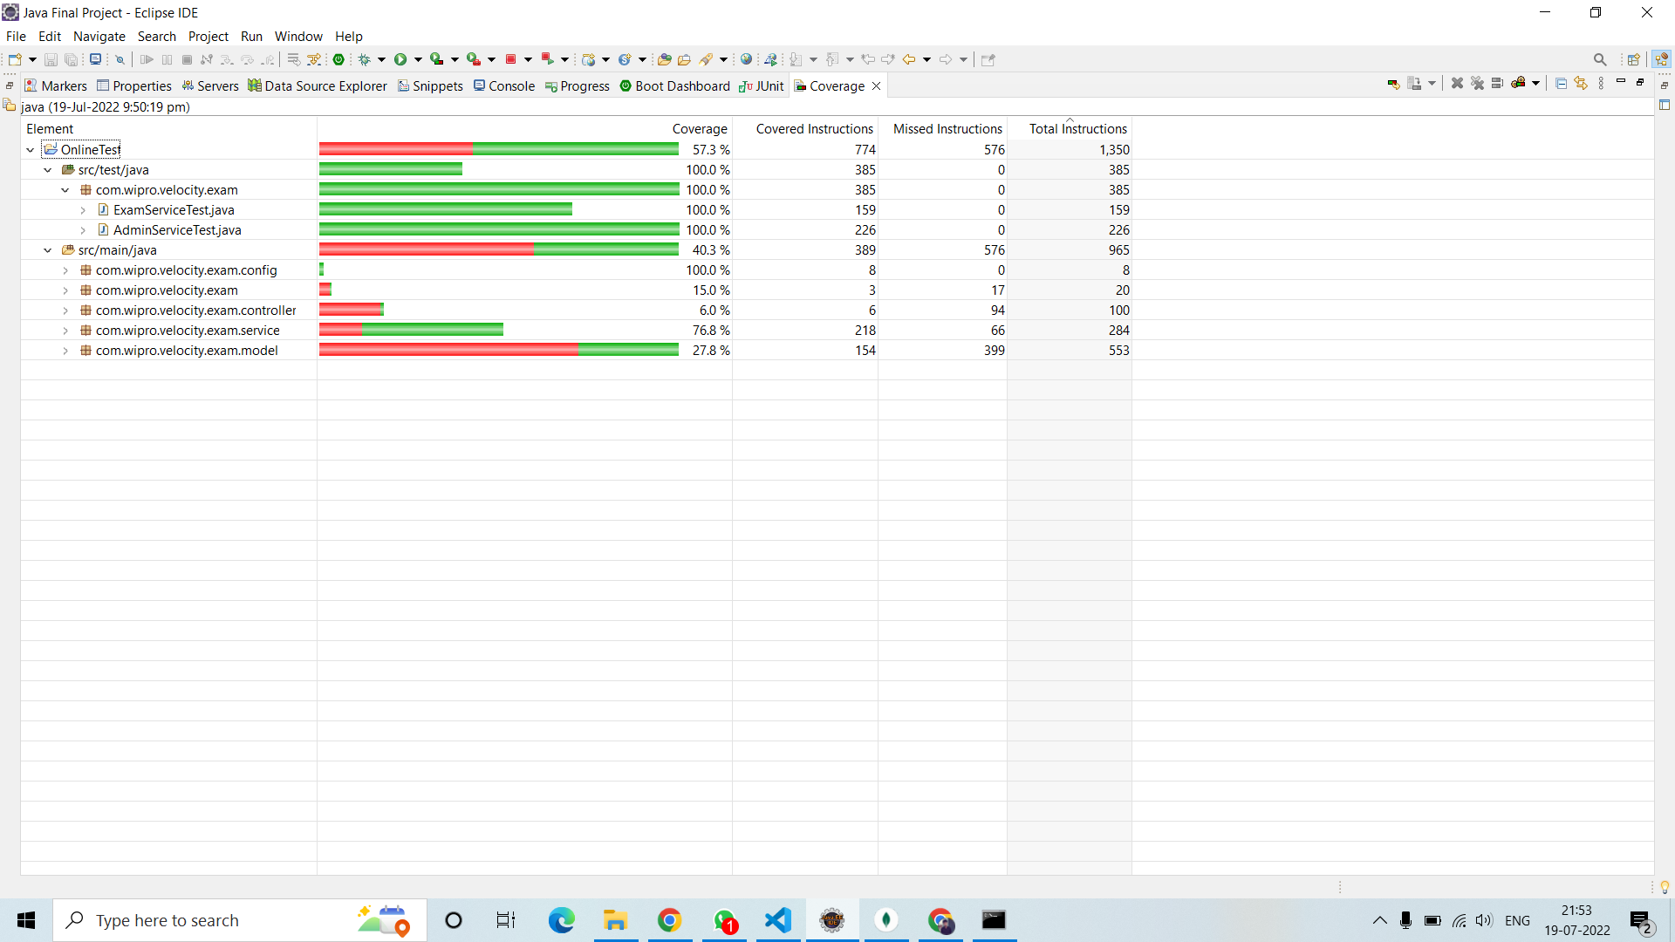
JUNIT REPORT

Slide 30
ADVANTAGES
Physical presence at a given location is absolutely not necessary.
No time spent on evaluation.
Results are available instantly.
Can be easily accessed 24/7 over the open test period.
Accuracy in checking the answer, calculating result.
User and Eco friendly.
Secure because of authentication.

Slide 31
CONCLUSION
Online Examination system is a web application. The key concept is to minimize the amount of paper and convert all forms of documentation into digital form.
It can observe that the information required can be obtained with ease and accuracy in the computerized system.
The user with minimum knowledge about computer can be able to operate the
system easily.
The system also produces brief result required by the management.

Slide 32

!

